Slide 1

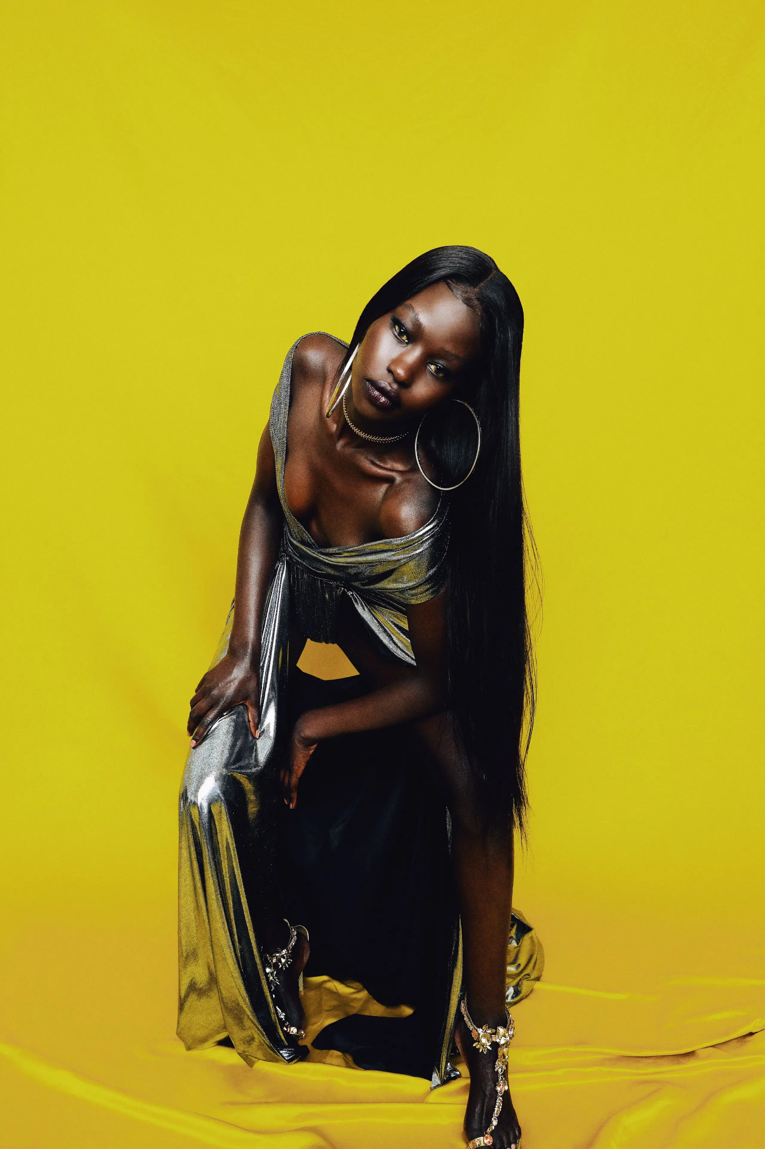

Fashion for Freedom
A Maono Collective Experience
Own Your Narrative
Date: March 2026,

Slide 2






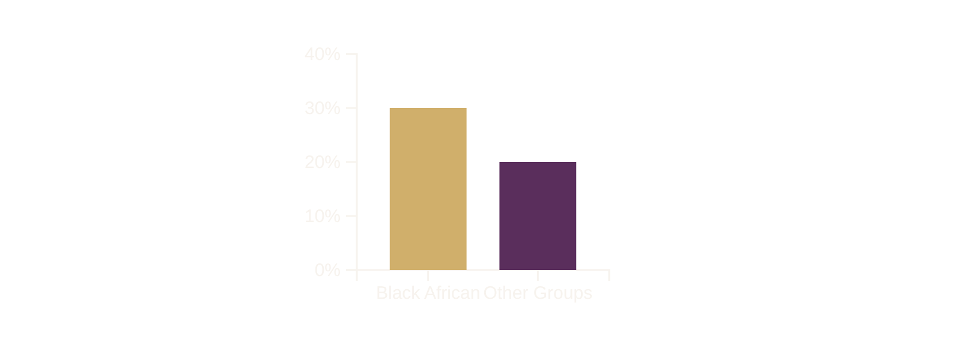
The Problem
Gender-Based Violence
Economic Exclusion
1 in 5
30%+
South African women aged 18+ have experienced physical violence
Black African women face highest unemployment rates
Source: Stats SA, 2023
Source: Stats SA, 2018; UNCTAD, 2022

Slide 3











THE SOLUTION
Economic Empowerment Platform
Creating opportunities for women in creative industries, contributing to financial independence
Visibility & Market Access
Fashion for Freedom
Providing a curated stage for emerging female designers to gain visibility in fashion industry
"Own Your Narrative"
Narrative of Strength
Using fashion to challenge harmful norms by promoting stories of resilience and autonomy

Slide 4
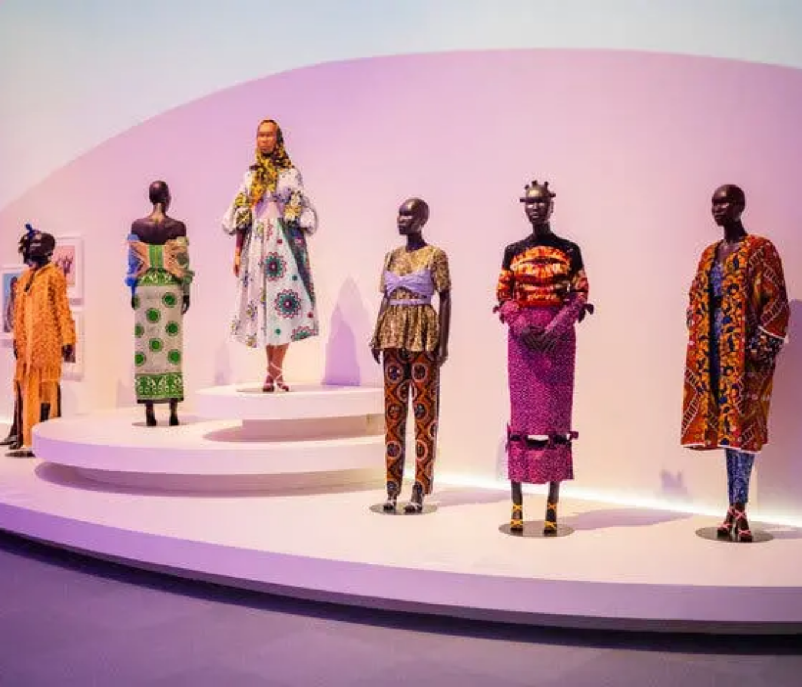













EVENT FORMAT
An Intimate Showcase
The "Fashion for Freedom" event offers an exclusive experience, fostering deep engagement and appreciation for the talent on display.
4
16
Emerging Fashion Designers
Unique Looks
2
1
Live Musical Performers
Master of Ceremonies
The event creates a sophisticated setting that highlights emerging creatives in a high-touch, exclusive atmosphere.
45-50
Intimately Curated Guests

Slide 5















WHO BENEFITS
Young Women Creatives
Ecosystem Impact
18-35
Female-Owned Suppliers
Supportive Network
Emerging female designers, models, and musicians gain:
Cultivating a network of women in creative industries fostering mentorship and collaboration
Prioritizing partnerships with female-owned businesses for catering, production, and event services
Valuable professional exposure
Networking opportunities
Direct pathway to economic empowerment
Addresses economic exclusion faced by young women in creative fields
Creating a sustainable ecosystem for women's creative empowerment that extends beyond the event

Slide 6



















PARTNERSHIP OPPORTUNITIES
Join the Maono Collective in amplifying the "Fashion for Freedom" experience
Supporter Tier
Partner Tier
Partner Tier
Investment Level
Investment Level
Investment Level
$5000 – R7,000
$10,000 - R25,000
$25,000+
Key Benefits
Key Benefits
Key Benefits
Access to event
All Supporter benefits
All Partner benefits
Networking opportunities
Brand visibility
Lead sponsorship
Collaboration opportunities
Strategic collaboration
Flexible In-Kind Options
We offer flexible in-kind collaboration options for partners who wish to contribute services, products, or expertise instead of cash.

Slide 7






NEXT STEPS
Join The Maono Collective
We invite you to champion "Fashion for Freedom" with us. Let's connect within the next 48 hours to explore partnership alignment.
Forge Empowering Collaborations
Email
Phone
magazinemaono@gmail.com
+27 78 181 4345
Schedule a Meeting

